Slide 1
Task 5
6/2/2023

Slide 2
Pose evaluation
Visual clustering
Audio Process & clustering

Slide 3
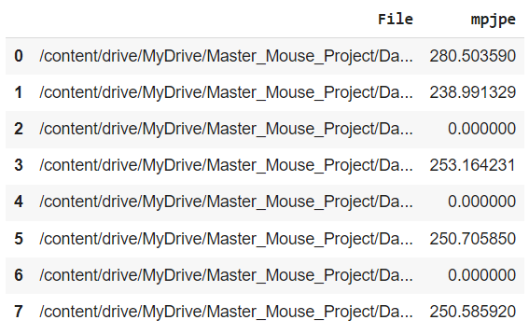
1. Pose evaluation
pose_evaluation.ipynb
mpjpe_evaluation.json
Problems:
Some problems with the results because there are more points than in the annotation.
Ignore extra points
Some datasets give me 0 as final results. I have to explore deeply what is happening.

Slide 4
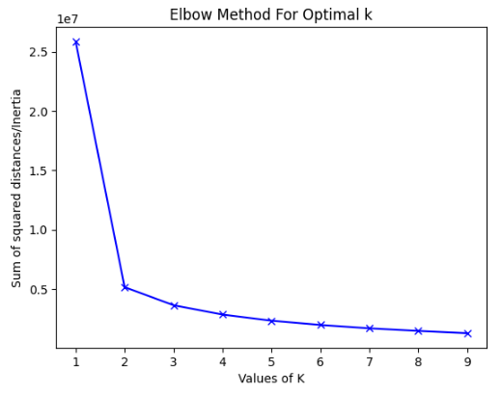

2. Visual clustering
vision_clustering.ipynb
Elbow method for optimal number of clusters -> optimal: 2 clusters
I used “A male in a new cage”
Problems:
Missing data of mouse2
Small number of clusters
One cluster per each file? Or combining files

Slide 5
3. Audio Process & clustering
Tools methods to process WAV files:
Audacity: Audacity is an open-source audio software that's available for Windows, macOS, Linux, and other Unix-like operating systems. It provides a broad range of capabilities such as recording, editing, and manipulating audio files.
SoX - Sound eXchange: SoX can convert various formats of computer audio files into other formats. It also applies various effects to these sound files and can work with WAV files. It's a command line utility, which means it's very powerful and flexible.
Adobe Audition: Adobe Audition is a comprehensive toolkit for audio editing. It allows users to mix, edit, and create audio content with a comprehensive toolset that includes multitrack, waveform, and spectral display.
FL Studio: FL Studio is a complete software music production environment or Digital Audio Workstation (DAW). It's best suited for music production but can also be used to edit and process audio files, including .wav format.
Ableton Live: Ableton Live is another digital audio workstation primarily aimed at live performances but it also provides the capabilities to compose, record, arrange, mix, and master your music.
Python with libraries such as scipy, numpy, and librosa: to write custom code to manipulate .wav files. Libraries such as scipy and numpy can handle the lower-level mathematical processing, while librosa is geared towards music and audio analysis.

